Slide 1

RNN: Next word prediction
Wilfred Djumin DAAA/FT/2B/05

Slide 2
TASK
1. Build a next word predictor given a sequence of words
2. Predict next 10 words for each given input of words
3. Find ways to evaluate generated sequence of words

Slide 3
Overview
Data Loading + EDA
Preprocessing (Tokenization, Input Output Pairs )
Modelling (SimpleRNN , GRU , LSTM ,etc.)
Evaluation (Accuracy , METEOR , Perplexity , Readability)
Improving on Models (Bi-LSTM & Bi-GRU)
Conclusions

Slide 4
Evaluation methods

Slide 5
Evaluation Methods
Model Accuracy (Train and Validation): As we are performing sequence generation, we should try to complement accuracy with other metrics, as generated text may not necessarily be classified into predefined categories
METEOR Score: considers precision, recall, stemming, synonymy, and word order, more on Quality of generated text, higher the better
Perplexity : Helps evaluate the fluency and coherence of generated sequences, the lower the score the better
Readability (Flesch Score): Assesses the ease with which a text can be read and understood
Human Evaluation: Creativity and appropriateness are challenging to be measured purely on metrics

Slide 6
Function: predict_next_N_words
This function generates a sequence of words given an initial input text using a trained RNN .
Input Parameters:
model: Trained RNN model.
input_text: Initial text for generating the sequence (seed texts in this case).
N_words: Number of words to generate (default: 10).
input_length: Maximum sequence length (default: max_sequence_len-1).
temperature: Controls randomness in the output (default: 1.0)
The temperature parameter allows for more “creative” generated texts by setting it >1.0 while also getting “precise” texts <1.0
Notes:
Temperature Scaling:
The logarithmic transformation (np.log(prediction) / temperature) scales the probabilities. Higher temperatures make the distribution flatter, allowing for more diverse predictions. Lower temperatures make the distribution sharper, leading to more focused predictions.

Slide 7
Data Loading & eda

Slide 8
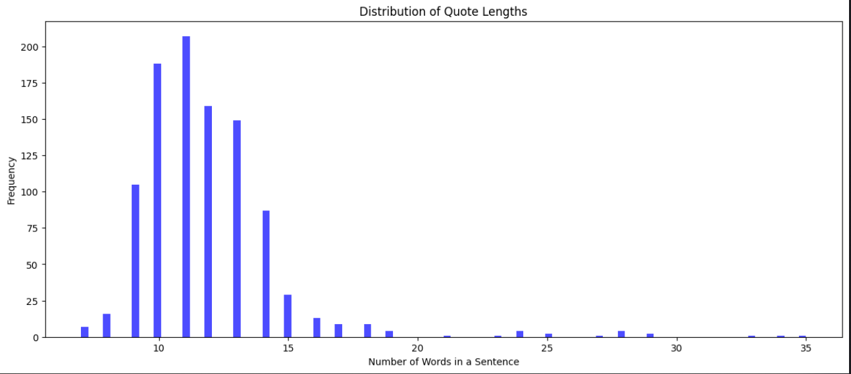
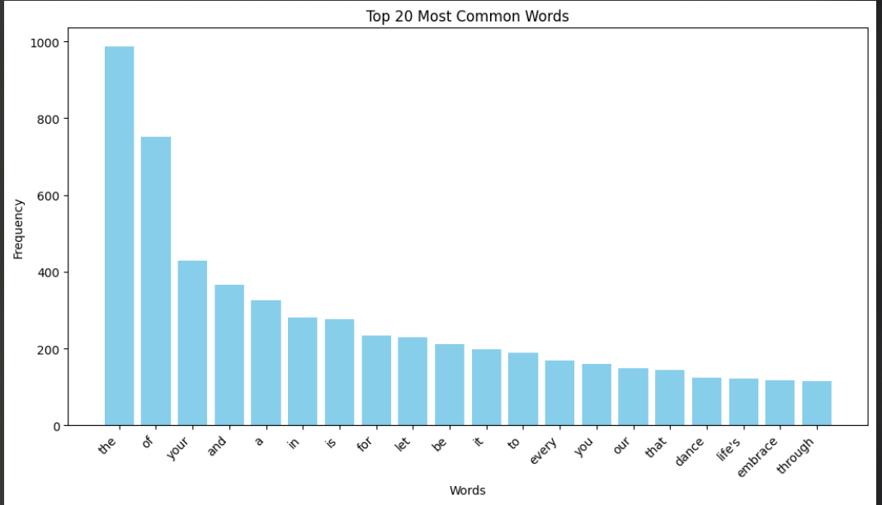
Data Loading & EDA
Our data contains 1000 quotes of 10 different ‘themes’ , each having 100 quotes per theme
Most quotes fall under 20 words, as seen from the distribution plot, while the maximum word count for a quote is 35
Most common words includes “the” , “of” and “your”

Slide 9
Preprocessing

Slide 10
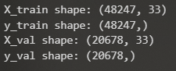
Tokenization & Input Output Pairs
For our case, we would try retaining punctuations like apostrophes, semicolons, and commas as they play a part in sentence sequence and coherence
To generate more Input Output pairs, we can make use of a loop, iterating through till the max sequence length of our data (35), and will consider every possible combination of lists ranging from 2 to 35 words which helps us get more data
We then pad them with the length of 35
We split X and y into train and validation sets with this shapes =>
Then apply One Hot Encoding to y_train and y_val

Slide 11
Modelling

Slide 12
SimpleRNN
Model Architecture
Embedding (128 )
SimpleRNN (64 )
Dropout (0.3)
Dense
“Precise” prediction (0.2 Temperature):
“radiate some positivity, for it is the heartbeat of transformation that our”
“Creative” prediction (2.0 Temperature):
'radiate some growth; it is the canvas, your reality spread wide open’
We notice that for the more “creative” sequence, it is more random put less meaningful as compared to the “precise” sequence which has a decent sentence structure
Train Accuracy of 0.75 , Validation Accuracy of 0.76
METEOR Scores of “Precise” text (0.375) was also higher than “Creative” text (0.285) which is expected since the “Creative” sequences are more random , which results in overall poorer quality

Slide 13
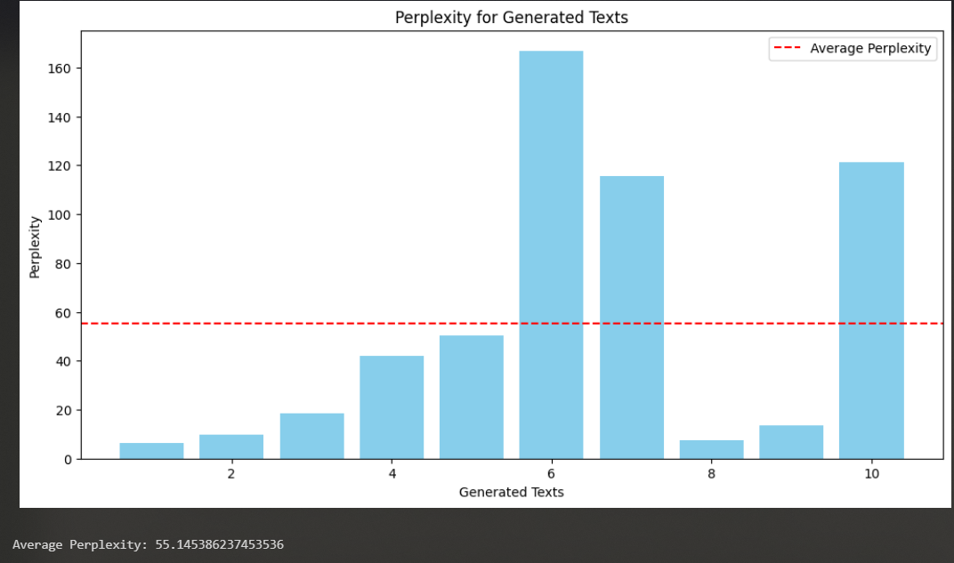
Perplexity of SimpleRNN
- The Model mainly struggles to continue sequences for seed text 6, 7 & 10 meaning that model is less certain and less accurate in predicting the next word
- Average Perplexity of 55.14
6: let your time and energy is the realization of your heart lead a day is
7: every person is a garden of kindness we plant its burdens be the
10: morning and evening would make it is the foundation of every action and decision shaping the

Slide 14
Model improvements

Slide 15
Bi-GRU
allows model to capture both past and future input sequences , wherelse regular GRU only has access to past input sequences
We would be using KerasTuner & GridSearch to tune:
Learning Rate
Dropout rate
No. of Layers
Nodes
“Precise” prediction (0.2 Temperature):
“radiate some confidence, and let it be the foundation of your greatness”
“Creative” prediction (1.5 Temperature):
'radiate some confidence, and let it be the armor that shields your’
We do notice that the generated sequences are more coherent and well structured, as compared to the ones that SimpleRNN generated
Train accuracy of 0.78 , Validation accuracy of 0.77 , improved a little vs SimpleRNN
METEOR Scores of “Precise” text (0.38) was also higher than “Creative” text (0.36) which is expected since the “Creative” sequences are more random , which results in overall poorer quality
“Precise” text also was more readable, having a higher FLESCH score of 66 (compared to 60)

Slide 16
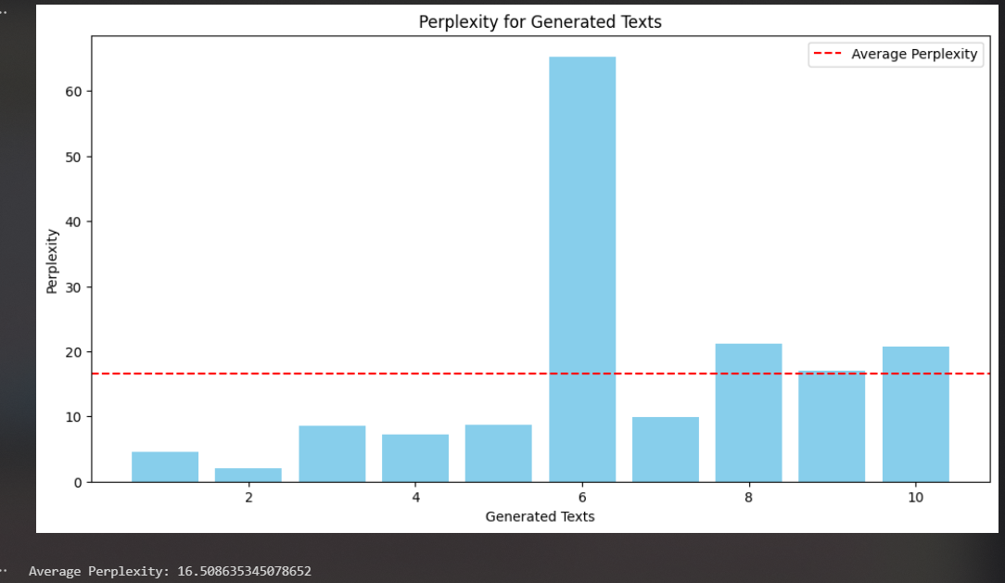
Perplexity of Bi-GRU
- Like SimpleRNN, Bi-GRU Model mainly struggles to continue sequences for seed text 6 , as the perplexity was the highest, which is common as seen in SimpleRNN
- Average Perplexity of 16.50 is lower than that of the SimpleRNN (55.14) , indicating a
6: let your time and energy ripples out, creating abundance around you leave behind a precious

Slide 17
Conclusions

Slide 18
Conclusions
Overall, GRU performed better than the SimpleRNN, but LSTM by itself did perform worse than SimpleRNN
However, using Bidirectional GRU / LSTM does help the model improve
Although most of our model’s accuracy were not as high(around 75% range), we shouldn’t solely look at accuracy metrics in the case of text generation, as it does not cover the fluency, coherence and relevance to the input or context
However, we could probably increase our model’s performance if we had performed some text augmentation
It can be quite challenging to evaluate the model’s “creativity” using a metric, and usually, human evaluation works better

Slide 19
Thank you

